Slide 1
Fits, Limits and Tolerances
Notes:
ENGR 112
CLASS 17.1

Slide 2
Learning Objectives
Apply linear tolerances in Metric systems (applied to holes and shafts)
Calculate the following parameters, given a dimensioned set of mating parts: Allowance, Clearance, Hole Tolerance, Shaft Tolerance.
Match Geometric Tolerance symbols with their meaning.
Apply Geometric tolerances with AutoCAD.

Slide 3
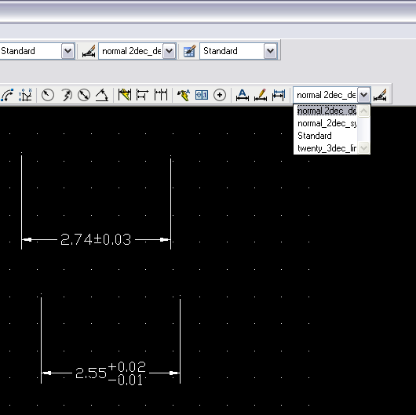
How to have multiple tolerance styles
Dimension Styles>New
  Name it: normal Dim
  Go in and set Tolerance precision .00
    Deviation upper .02 lower .01
Make all kinds of dimension styles, select using pull down menu

Slide 4
Tables
Special layouts can be done manually using rectangles, text command, copy, etc
Array command can extend rows

Slide 5
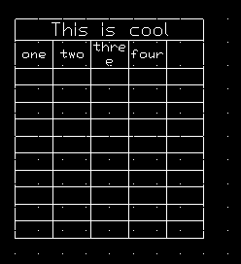
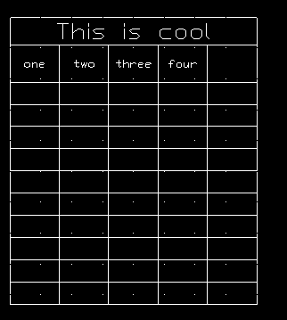
Table Command
Type Table, then choose number of rows, columns, etc.
Easy to insert text
Can stretch or shrink table
May not conform to unique layout needs
Text size can be modified
  Shift click all boxes
  R-click>Properties text height

Slide 6
Tolerance ???
The Oxford English dictionary defines tolerance as:
    b. In Mech., an allowable amount of variation in the dimensions of a machine or part. More widely, the allowable amount of variation in any specified quantity
    Or, paraphrased… “Tolerance is how accepting of errors you are”.

Slide 7
General Concepts
A measurement with a zero tolerance is impossible to manufacture in the real world.
Tolerances on parts contribute to the expense of a part, the smaller the tolerance the more expensive the part.

Slide 8
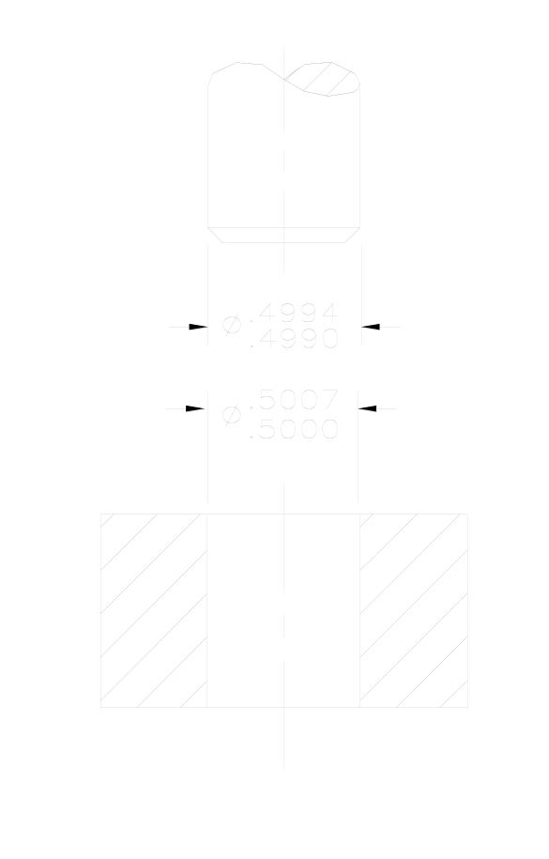
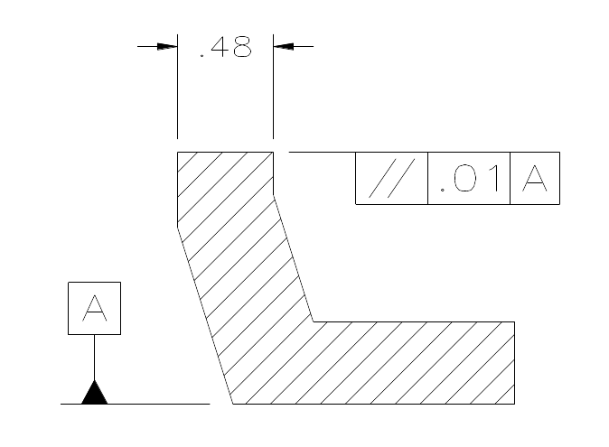
Types of Tolerances
General Tolerances –Limit the error a machinist is allowed on all dimensions, unless otherwise specified
Linear Tolerances –Specific error limits for a particular linear measurement.
Geometric Tolerances– Error limits, not on the size, but on the shape of a feature.

Slide 9
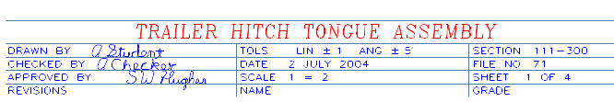
General Tolerance
Are specified in the title block of a drawing.
Must always be included on “real” parts.
.

Slide 10
Linear Tolerance
Is an overriding tolerance which specifies a tolerance for one specific dimension.
Can be listed in limit or deviation form, but normally should be specified on an engineering drawing in limit form.
Should only be used in the case of real necessity, not just because.

Slide 11
Example of Linear Tolerance
The parts shown to the right illustrates a linear tolerance shown in limit form.

Slide 12
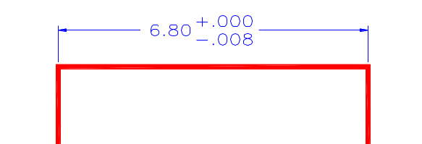
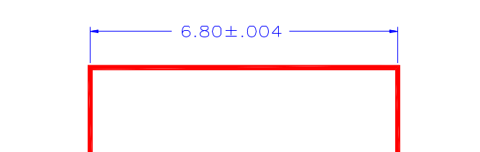
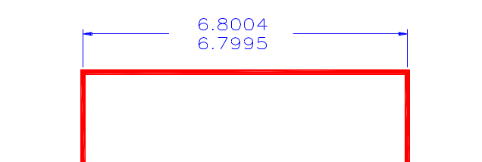

“Forms” of Linear Tolerance
Unilateral.
Variation in
one direction
Bilateral.
Variation in
two directions
Limit.
Max & Min..
largest on top

Slide 13


Terminology:
There are four parameters of interest:
  Hole Tolerance.
  Shaft Tolerance.
  Allowance.
  Maximum Clearance.

Slide 14
Hole Tolerance
The difference between the diameters of the largest and smallest possible holes.
Determines the cost of manufacturing the hole.
Does not consider the Shaft at all.

Slide 15
Shaft Tolerance
The difference between the diameters of the largest and smallest possible shafts.
Determines the cost of the shaft.
Does not consider the Hole at all.

Slide 16
Allowance
The tightest fit between two mating parts.
Determines how the two parts will interact with one another.
Smallest hole minus largest shaft.
  Or the “gap” between smallest hole & largest shaft.
Does not affect the cost of the parts.

Slide 17

Maximum Clearance
The loosest fit between mating parts.
Determines how the two parts will interact with one another.
Largest hole minus smallest shaft.
  Or the “gap” between largest hole hole & smallest shaft.
Does not affect the cost of the parts.

Slide 18
Formulas for calculation
Hole Tolerance = LH - SH
Shaft Tolerance = LS - SS
Allowance = SH - LS
Maximum Clearance = LH - SS
LH=Large Hole, SH=Small Hole
LS-Large Shaft, SS=Small Shaft

Slide 19
Other definitions
Nominal Size - The approximate size of a part.
Actual Size - The measured size of a finished part.
Basic Size - The exact theoretical size for a part, used to calculate the acceptable limits.
Hole Basis - A system of fits based on the minimum hole size as the basic diameter.

Slide 20
Practical Application
This class is not trying to teach the design aspect of tolerance
We will be interested in applying a given tolerance to a part, not in determining the “best” tolerance
Various industries (aerospace, electronics, automotive, etc.) set their own tolerances.

Slide 21
Types of Fits
Linear tolerances can be classified in 4 major categories, based on the interaction between the parts :
  Clearance Fit.
  Line Fit.
  Transition Fit.
  Interference Fit (Force Fit).

Slide 22
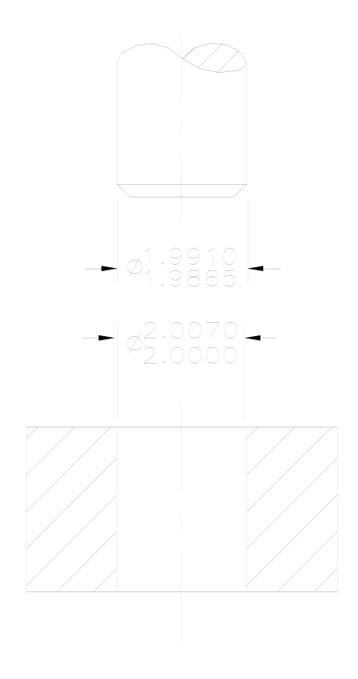
English Example
Running and sliding fit RC9
Basic diameter 2.00”
  Hole limits +7.0, 0
  Shaft limits -9.0, -13.5
Max Clear ????
Allowance ????
Hole Tolerance. ????
Shaft Tolerance ????

Slide 23
Clearance Fit
In a clearance fit, the two parts will always fit together with room to spare

Slide 24
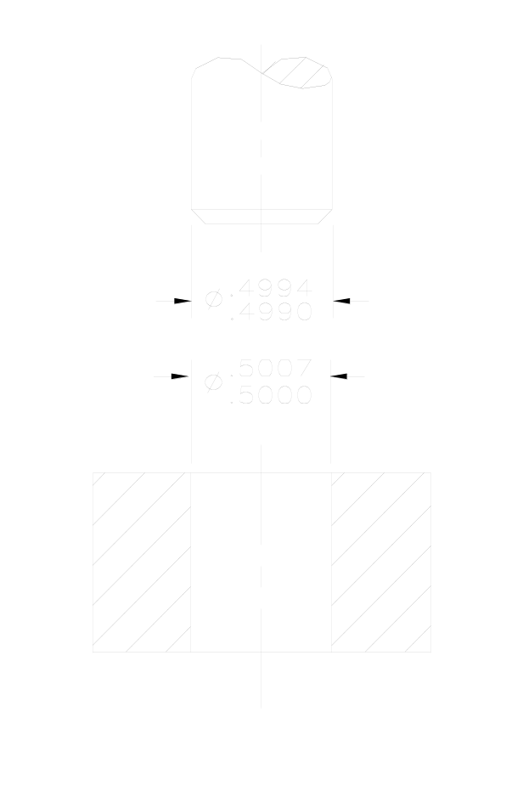
Clearance Fit
In a clearance fit, the two parts will always fit together with room to spare
As a team, calculate the: Hole Tolerance.______ Shaft Tolerance.______ Allowance.__________ Clearance. __________ for the fit shown …⇒

Slide 25
Clearance Fit
In a clearance fit, the two parts will always fit together with room to spare
As a team, calculate the: Hole Tolerance. .0007 Shaft Tolerance. .0004 Allowance. .0006 Clearance. .0017

Slide 26
Line Fit
In a line fit, the two parts may fit together with no room to spare

Slide 27

Line Fit
In a line fit, the two parts may fit together with no room to spare
As a team, calculate the: Hole Tolerance._____ Shaft Tolerance._____ Allowance. _________ Clearance. _________ for the fit shown ……⇒

Slide 28
Line Fit
In a line fit, the two parts may fit together with no room to spare
As a team, calculate the: Hole Tolerance. .0007 Shaft Tolerance. .0010 Allowance. 0 Clearance. .0017

Slide 29
Transition Fit
In a transition fit, the two parts may either clear or interfere with each other…probably the cheapest way to manufacture products. Used with selective assembly process

Slide 30
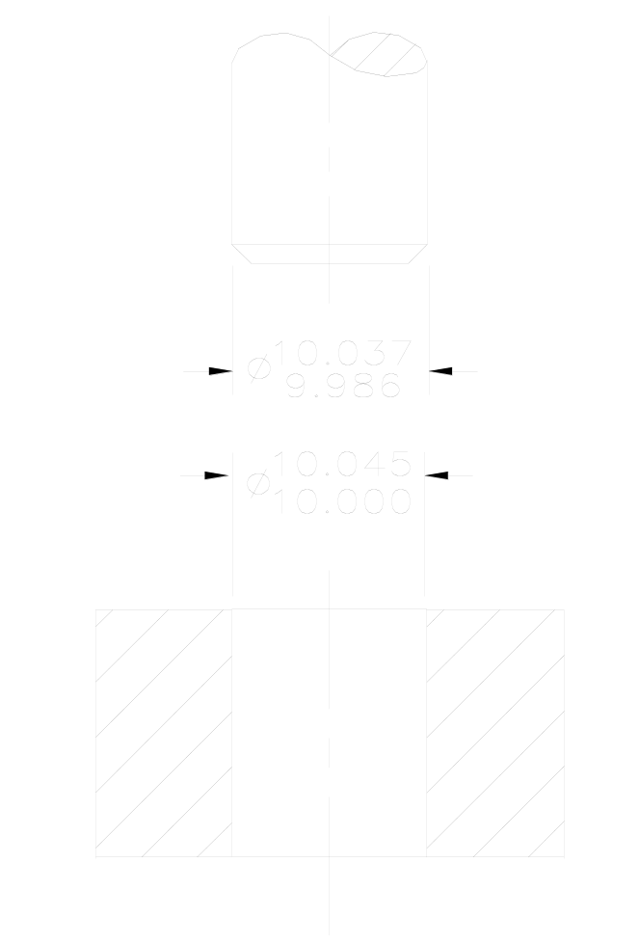
Transition Fit
In a transition fit, the two parts may either clear or interfere with each other
As a team, calculate the: Hole Tolerance._____ Shaft Tolerance._____ Allowance._________ Clearance.__________ for the fit shown to the right. …………….⇒

Slide 31
Transition Fit
In a transition fit, the two parts may either clear or interfere with each other
As a team, calculate the: Hole Tolerance. .045 Shaft Tolerance. .051 Allowance. -.037 Clearance. -.059

Slide 32
Interference Fit
In an interference fit, the two parts will always interfere with each other, requiring a force or press fit

Slide 33
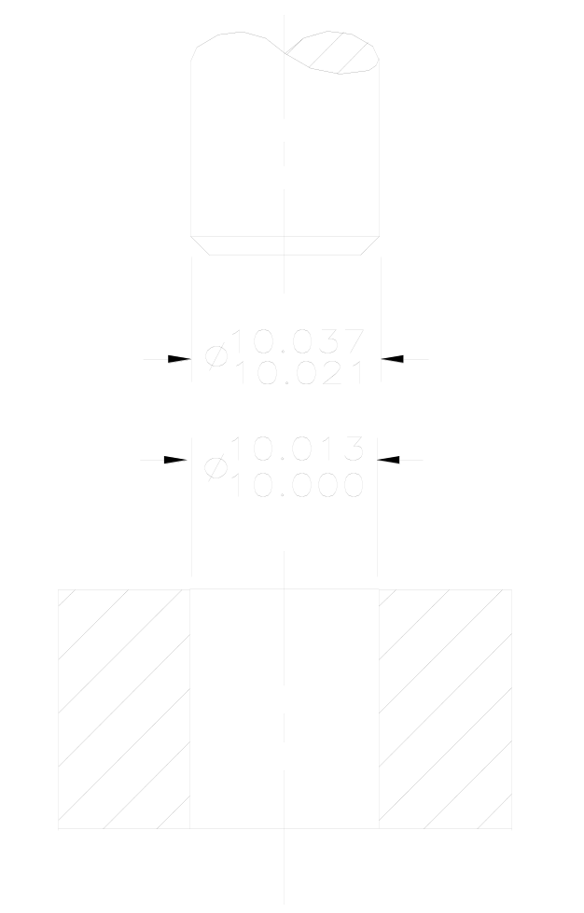
Interference Fit
In an interference fit, the two parts will always interfere with each other, requiring a force or press fit
As pairs, calculate the Hole Tolerance.________ Shaft Tolerance.________ Allowance.____________ Clearance._____________ for the fit shown to the right. ………………⇒

Slide 34
Interference Fit
In an interference fit, the two parts will always interfere with each other, requiring a force or press fit
As pairs, calculate the Hole Tolerance. .013 Shaft Tolerance. .016 Allowance. -.037 Clearance. -.008

Slide 35
Metric Fits
See Appendix p748-751
Clearance Fits
H11/c11 | Loose Running: For wide commercial tolerances on external members.
H9/d9 | Free Running: For large temperature variations, high running speeds, or heavy journal pressures.
H8/f7 | Close Running: For accurate location and moderate speeds and journal pressures.
H7/g6 | Sliding: Fit not intended to run freely, but to turn and move freely, and to locate accurately.
H7/h6 | Locational Clearance: Fit provides snug fit for locating stationary parts; but can be freely assembled and disassembled.
Transition
H7/k6 | Locational Transition: Fit for accurate location, a compromise between clearance and interference.
H7/n6 | Locational Transition: Fit for more accurate location where greater interference is permissible.
Interference
H7/p6 | Locational Interference: Fit for parts requiring rigidity and alignment with prime accuracy of location, but without special bore pressure requirements.
H7/s6 | Medium Drive: Fit for ordinary steel parts or shrink fits on light sections, the tightest fit usable with cast iron.
H7/u6 | Force: Fit suitable for parts which can be highly stressed or for shrink fits where the heavy pressing forces required are impractical.

Slide 36
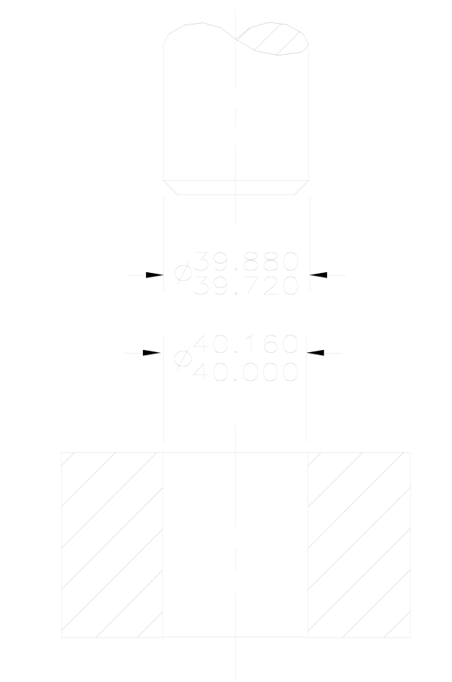
Metric Example
H11/c11 (loose running)
Basic diameter 40 mm
  Hole size 40.160,40.000
  Shaft size 39.880,39.720
Max Clear ????
Allowance ????
Hole Tolerance ????
Shaft Tolerance ????

Slide 37
Metric Example
H11/c11 (loose running)
Basic diameter 40 mm
  Hole size 40.160,40.000
  Shaft size 39.880,39.720
Max Clear 0.440
Allowance 0.120
Hole Tolerance 0.160
Shaft Tolerance 0.160

Slide 38
Geometric Tolerances (see Ch11)
Geometric tolerancing is a system that specifies tolerances that control location form, profile, orientation, location, and runout on a dimensioned part
NOTE:
Many standard symbols are
Used to represent “Geotol”
Relationships…parallel,
perpendicular, angular,
round, and flat are fairly obvious

Slide 39
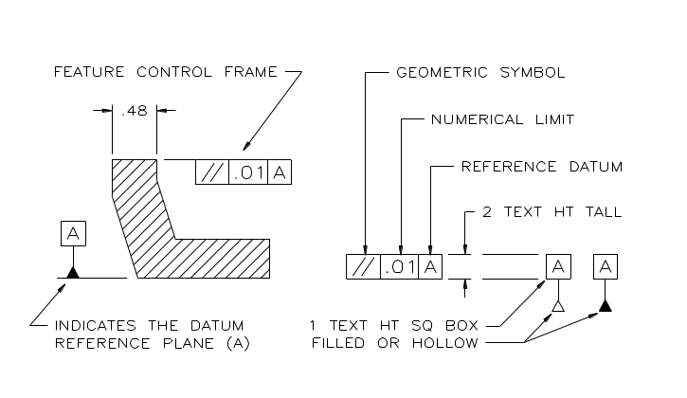
Geometric Tolerances See Ch11
Feature control boxes (call outs) are used to place geometric tolerances in most drawings. Standard letter height is recommended (1/8-in or 3 mm)

Slide 40
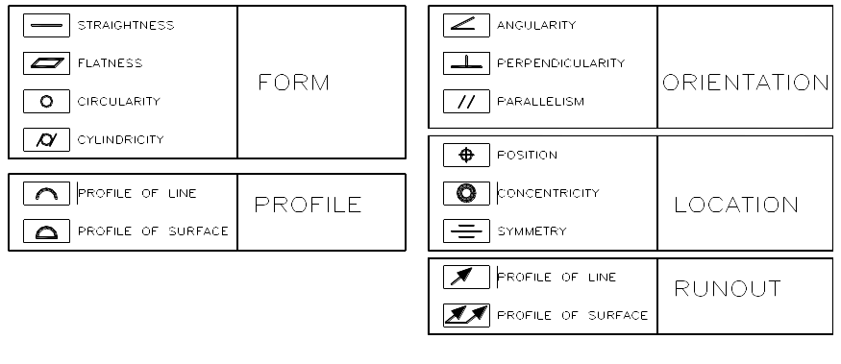
Geometric Tolerances
L LMC….Least Mat’l Cond.
M MMC...Max Mat’l Cond.
R RFS…..Regardless of Feature size.

Slide 41
Some terminology
Feature Tolerance—what we’ve been doing
  Lengths, angles, diameters, etc
  Refers to the error in manufacturing feature
Geometric Tolerance—specs shape variat’n
  Flatness of a surface to 0.3
  Straightness of a shaft about it’s centerline
  Circularity of a cylinder

Slide 42
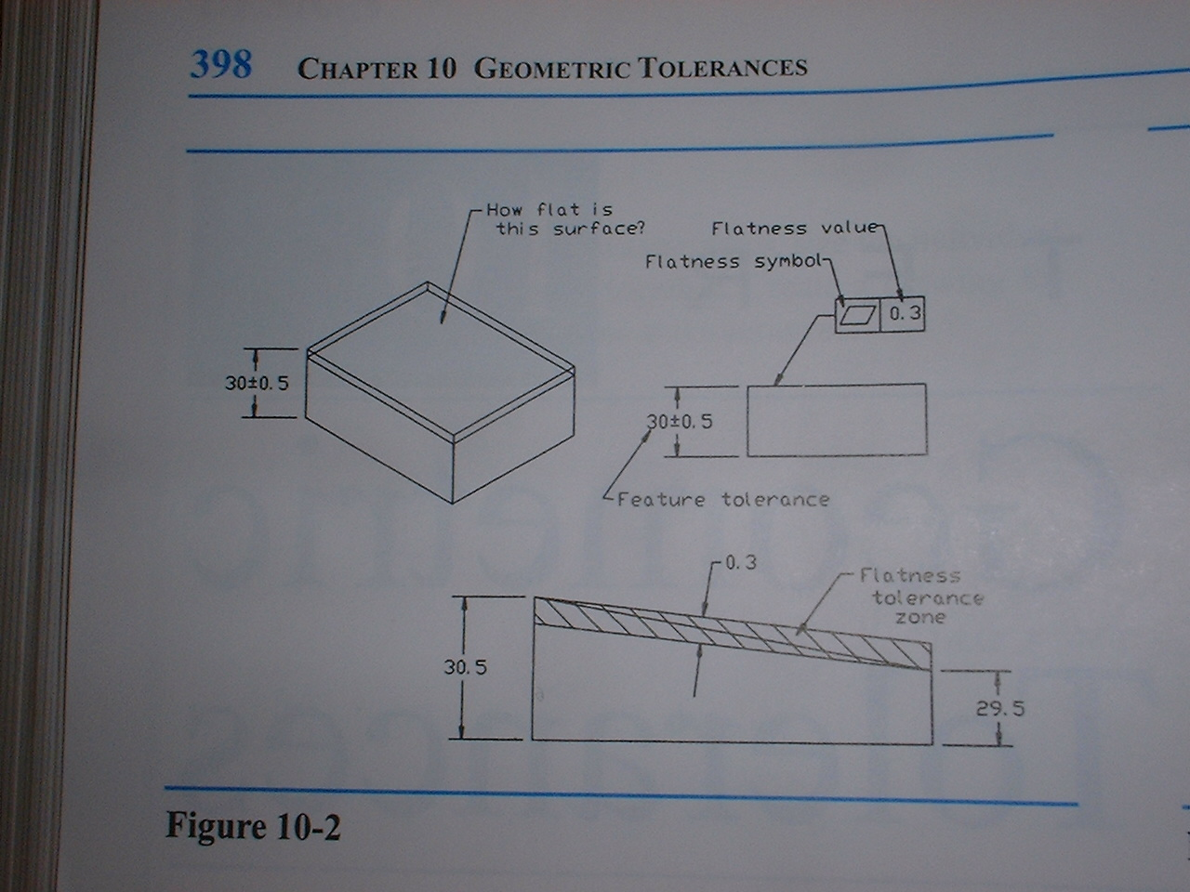

Slide 43
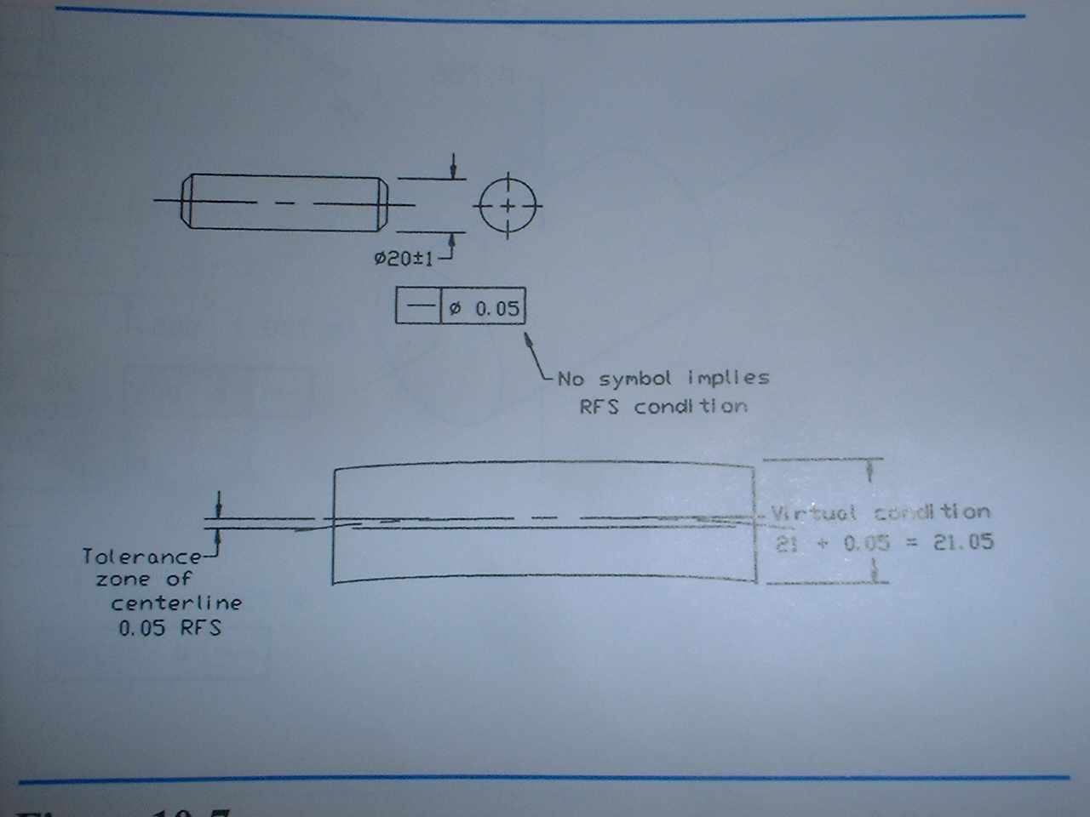

Slide 44
RFS and MMC
Regardless of Feature Size (RFS)—
    See additional ppt on this weeks calendar entry
Maximum Material Condition

Slide 45
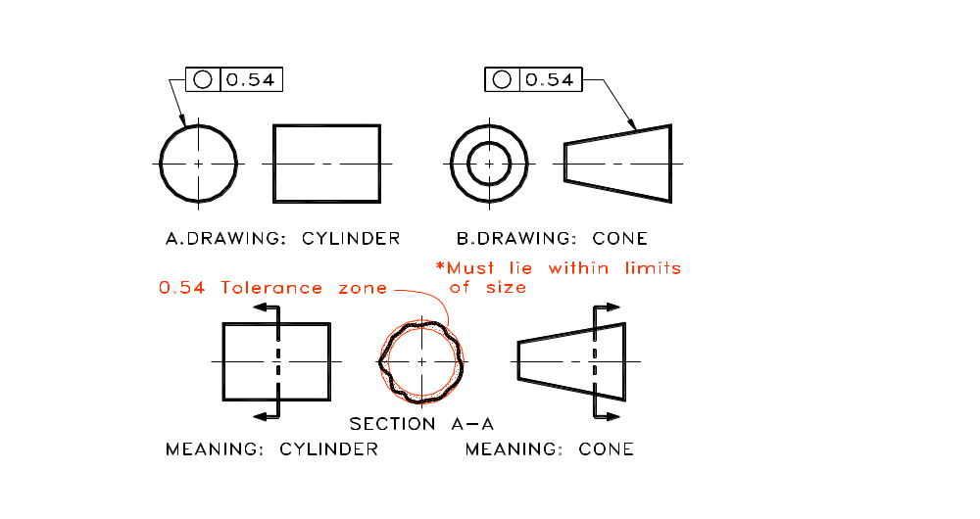
Use of a Callout

Slide 46
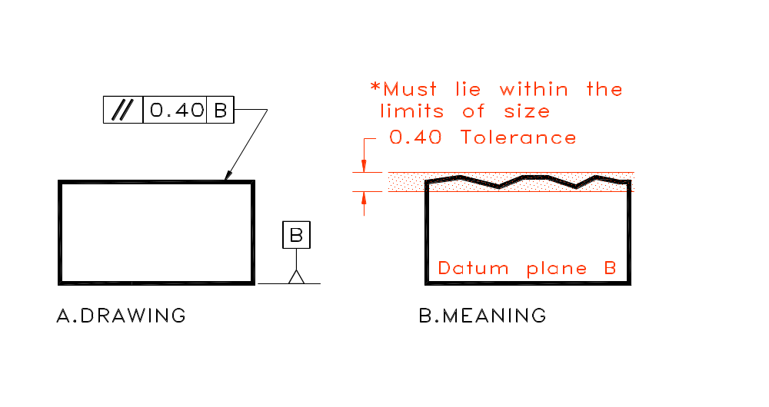
Use of a Datum and Callout

Slide 47
Geometric Tolerances in ACAD
Geometric tolerances in AutoCAD are normally applied on the end of a leader
After invoking the quick leader command, but BEFORE selecting any points, you can select settings to allow the placement of a callout box, rather than a note

Slide 48
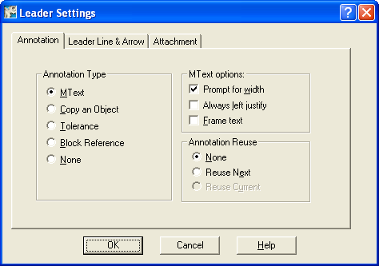
Leader Settings Dialogue box

Slide 49
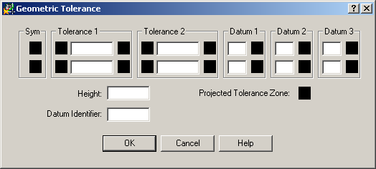
Tolerance option
If you select the Tolerance option you will be presented with the following dialogue box rather than a text prompt

Slide 50
Adding a Datum Reference
Following the same procedure for getting a callout box to get a datum identifier
When completing the dialogue box, enter the letter of the datum in the “Datum Identifier” space toward the bottom of the box.
Pages 82-85 in the Essentials of AutoCAD book demonstrate how to place a geometric tolerance.

